Slide 1
Case Study - Holmgren Engineering
By Group 9
Khushboo Rani -19146
Nidhil Krishna – 19152
Rahul Singh - 19160
Shivansh Sharma - 19168
Suhas M S - 19174
Syeda Zaiba - 19180

Slide 2
Case Outline
Case is based on the company named “Holmgren Engineering”
John Svensson is the CEO.
Peter Wilkund is the engineer who is proposing changes.
Holmgren Engineering is involved in manufacturing and selling of water storage system.
Products are sold throughout Sweden and parts of Europe.

Slide 3
Products of Holmgren Engineering
Water Heater Storage system.
The product range under Hetvatten plus vary slightly only in size and capacity.
Huge delivery lead time of 3-4 weeks.

Slide 4

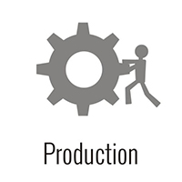
Operations of Holmgren Engineering
Batch processing (batch size of 5).
Haphazard structure of layout
Parts to be used are bulk ordered every week.
Inventory to be used are brought in from different building
Forecast done based on known orders with week 1 fixed and week 2-4 tentative.

Slide 5
Proposed Changes by Mr. Wilkund
One-piece flow of work instead of batch processing.
Layout changed to U-shaped freeing up the space.
Make-to-order.
Sub-assembly stock.
Reducing lead time.

Slide 6
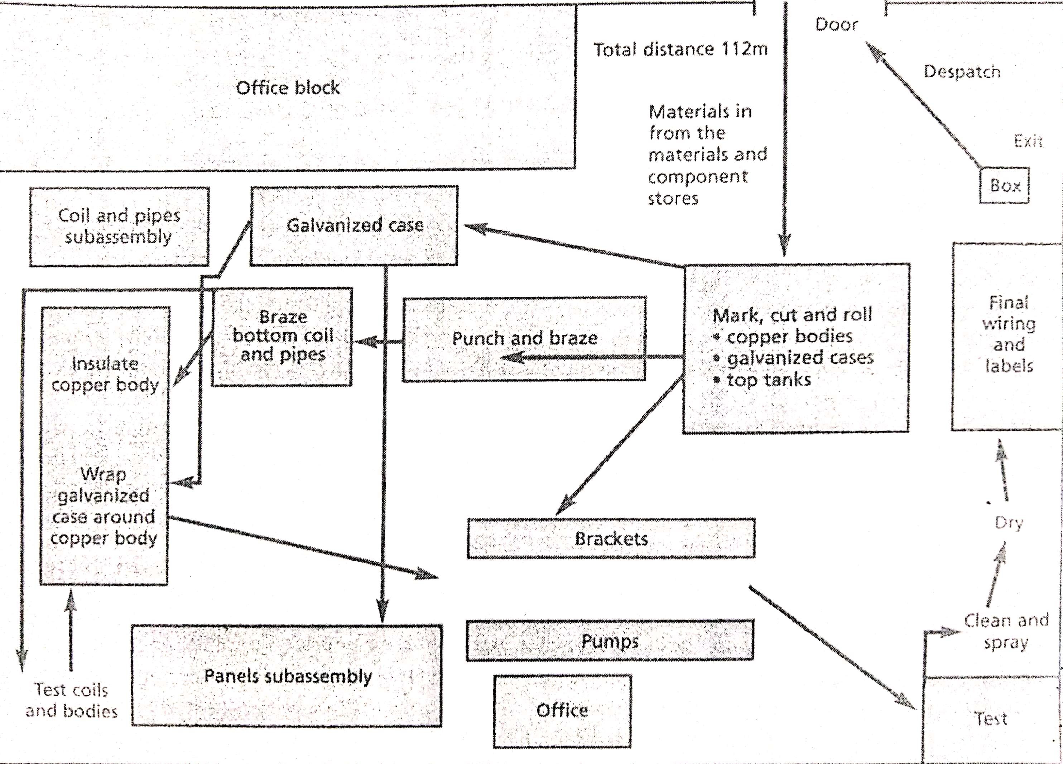

Slide 7
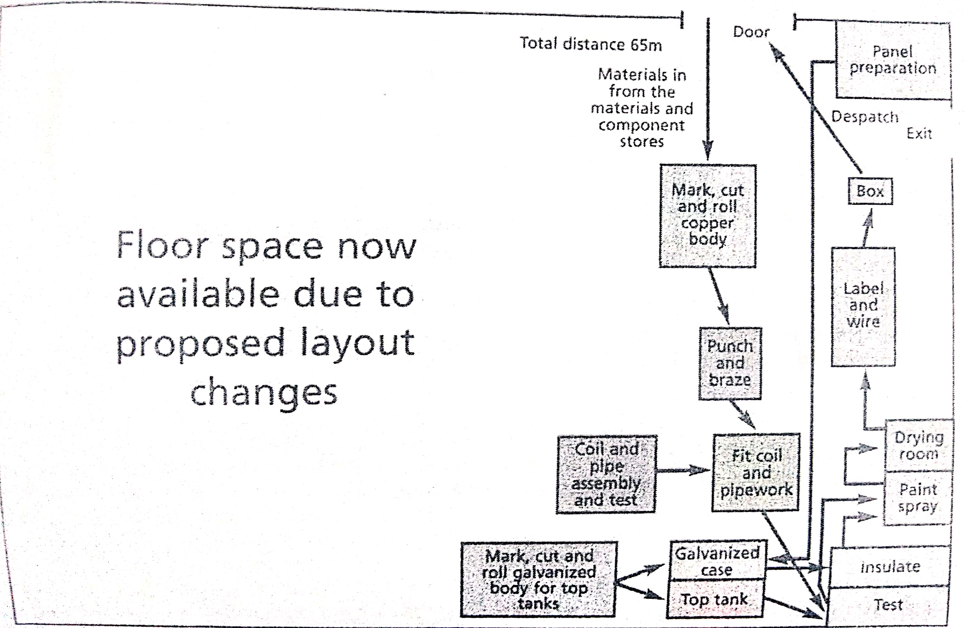

Slide 8
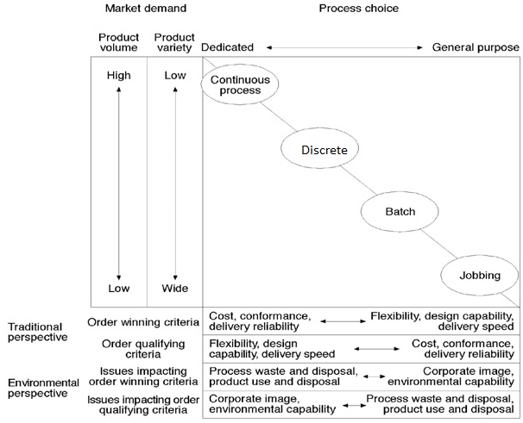
Why the recommended changes will work ?

Slide 9
On what basis does the product engineer propose changes :
Alternatives | MTO vs MTS | Sub assembly stock | Dimension and score (1= Good, 4=Poor) |  |  |  |  |  | Total score
 |  |  | Efficiency | Inventory | Speed of through-put | Space/ movement | Response/variability | Quality
1 | MTS | Yes | 1 | 4 | 3 | 4 | 3 | 4 | 19
2 | MTS | No | 3 | 3 | 4 | 3 | 3 | 2 | 18
3 | MTS | Yes | 2 | 3 | 1 | 2 | 3 | 2 | 13
4 | MTS | No | 4 | 2 | 2 | 1 | 3 | 1 | 13
5 | MTO | Yes | 1 | 3 | 3 | 4 | 1 | 4 | 16
6 | MTO | No | 3 | 2 | 4 | 3 | 1 | 2 | 15
7 | MTO | Yes | 2 | 3 | 1 | 2 | 1 | 2 | 11
8 | MTO | No | 4 | 1 | 2 | 1 | 1 | 1 | 10

Slide 10
Examine the current operations process used at Holmgren Engineering. What are the key features of making products ?
Batch Process of 5 units, involving four principal sub-assemblies of copper body, top tank, galvanised casing and the electrical unit.
Though batch production may seem feasible at first glance it however creates delays. Because the production lines must halt between batch runs.
Identical units produced in lots.
Any loss and damage is independent of batches
High delivery lead time.

Slide 11
What are the key changes that enable the proposed method of production (one-piece flow ) to work?
The change in the layout from haphazard to U-shaped makes the process flow of work easier and it also saves time.
Sub-assembly stock suggested will aid in speeding up the one-piece flow of work.
One-piece flow of work will help attaining just-in-time manufacturing with subassembly stock in hand.
Other perceived benefits:
Increases flexibility - Reduces lead time
Increases quality - No WIP and FG stock.

Slide 12
Evaluate the benefits of these proposed changes and highlights the principal gains to be made.
Reduction in the delivery lead time from 3-4 weeks.
Increases operational efficiency.
When we “make one, move one”, defects are detected immediately (usually the next workstation) forcing immediate corrective action.
The proposed change in the layout that is to U-shape, frees up the floor space
Relaxing space for the employees/workers
The floor space can also be used to increase the production line and the volume of production. This will reduce the cost per unit thus bringing cost efficiency.

Slide 13
What factors would need to be carefully managed to ensure a successful implementation of these proposals?
Smooth Logistics support from the suppliers to succeed in just-in-time process.
Proper delegation of work and authority.
Coordination between different organizational departments.
Contributes towards revenue as expenses can be reduced substantially.
Thus, the above factors will lead to the improvement of supply chain management.

Slide 14
Merits and De-Merits of the Proposed Changes
Merit | Demerit
Nearly 50% free up in floor space. Thus, reduction in labour content and reduction in distance travelled by typical product. | No risks and uncertainty taken into consideration.
Work in progress inventory will be reduced to SKr 36000 | No importance given to frequency of ordering.
One-piece flow of work and Sub assembly stock. | Make-to-order can at times give scope to customer to prefer other company cause of delay in product.
Better human resource management and cost efficiency.

Slide 15
Recommendations
Free space to increase product line expansion and production volume.
Free space can also be used for the short breaks of labour/employees which will indirectly boost productivity and increase employee morale.
Instead of only make-to-order they can prefer assemble-to-order to manage the orders more efficiently with reduced delivery lead time.
Another reason to recommend this is that Sweden being a country with cooler summer the demand for product can be year long.

